Slide 1
Sleep & Habits Analysis
Qasem Alkorom

Slide 2
Mini Update #1 - Data Profile
This dataset has 374 rows and 13 columns
Column Name | Has missing value? | Data Type(Discrete or numeric or free text) | Useful? | Need cleaning or processing?
Gender | No | Discrete | Yes | No
Age | No | Numeric | Yes | No
Sleep Duration | No | Numeric | Yes | No
Quality of Sleep | No | Numeric | Yes | No
Stress Level | No | Numeric | Yes | No
BMI Category | No | Discrete | Yes | No
Sleep Disorder | Yes | Discrete | Yes | Maybe

Slide 3
Curious Questions
Does getting more sleep reduce stress levels?
How does physical activity affect sleep quality?
Do people with higher BMI have worse sleep?
Is there a difference in sleep between males and females?
Does age impact how long people sleep?
Do people with higher stress sleep fewer hours?
How does daily steps relate to sleep quality?

Slide 4
Audience + Goal
Audience:
College students and young adults who want to improve their sleep and daily habits.
Communication Goal:
To help people understand how lifestyle factors like activity, stress, and health affect sleep so they can make better decisions.

Slide 5
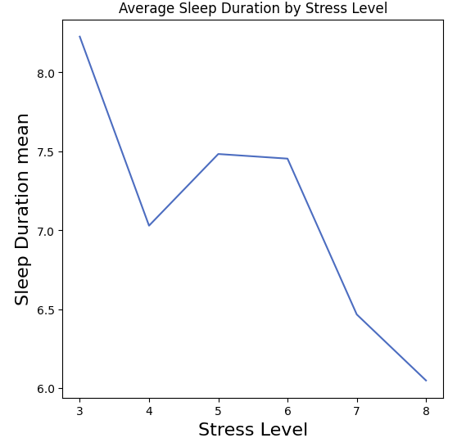
Sleep Duration Decreases as Stress Increases
This graph shows the average sleep duration for each stress level.
As stress levels increase, the average sleep duration generally decreases. People with higher stress tend to get less sleep.

Slide 6
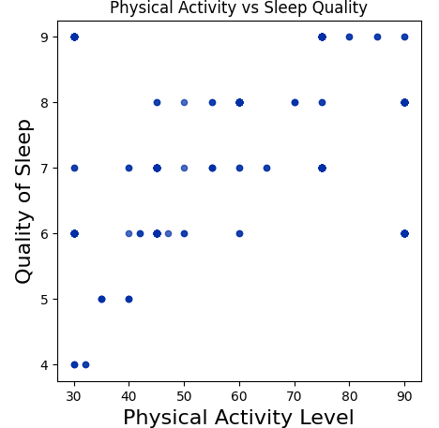
Higher Physical Activity is Linked to Better Sleep Quality
This graph shows the relationship between physical activity level and sleep quality.
As physical activity increases, sleep quality generally appears to improve. People who are more active tend to have better sleep.

Slide 7
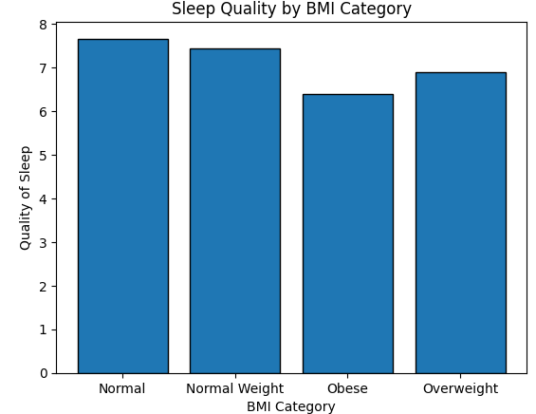
Sleep Quality Varies by BMI Category
This graph shows the average sleep quality for each BMI category.
People with normal BMI tend to have higher sleep quality, while those in the obese category have lower sleep quality. This suggests that BMI may be related to sleep health.

Slide 8
Progress Update
What I accomplished:
Created 3 data insight slides analyzing sleep, stress, physical activity, and BMI
Generated graphs using the dataset and interpreted key trends
Plan for next week:
Create more data insights
Start identifying the main story and key takeaway
Obstacles:
None so far
Resources used:
Jupyter Notebook
Course materials
Contribution:
All work completed individually

Slide 9
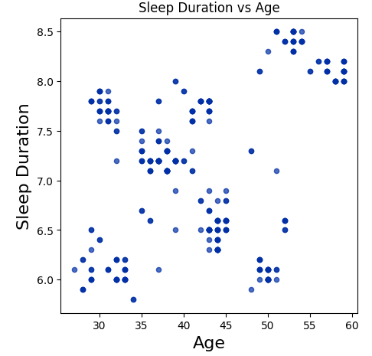
Sleep Duration Varies Across Age Groups
This graph shows the relationship between age and sleep duration.
Sleep duration does not follow a clear trend with age, but it varies across different age groups. Some younger individuals appear to get less sleep, while certain older groups tend to get slightly more.

Slide 10
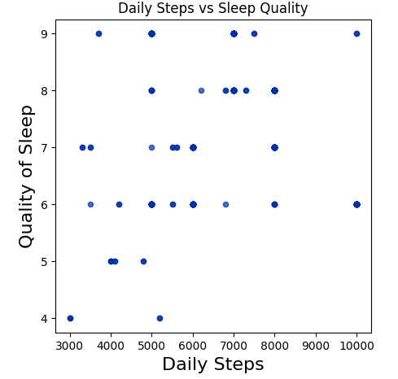
Daily Steps May Be Linked to Better Sleep Quality
This graph shows the relationship between daily steps and sleep quality.
There is no perfectly clear trend, but people with higher daily steps often appear to have better sleep quality. This suggests that being more active may be linked to better sleep.

Slide 11
Progress Update – Week 3
What I accomplished:
Added 2 new data insight slides (Age and Daily Steps)
Expanded analysis to explore more lifestyle factors related to sleep
Plan for next week:
Identify the strongest insights
Begin shaping a clear overall data story
Obstacles:
None so far
Resources used:
Jupyter Notebook
Contribution:
All work completed individually

Slide 12
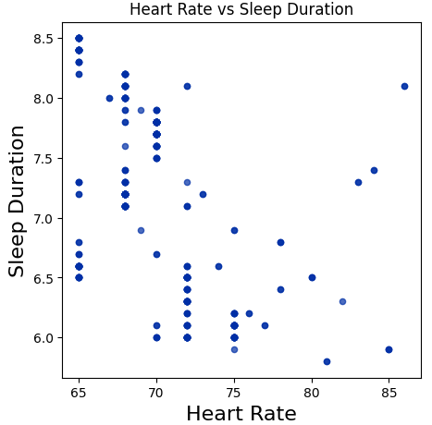
Higher Heart Rate May Be Linked to Lower Sleep Duration
This graph shows the relationship between heart rate and sleep duration.
There is no perfectly clear trend, but individuals with higher heart rates often appear to get slightly less sleep. This may suggest that higher heart rate, which can be linked to stress or health factors, could negatively impact sleep duration.

Slide 13
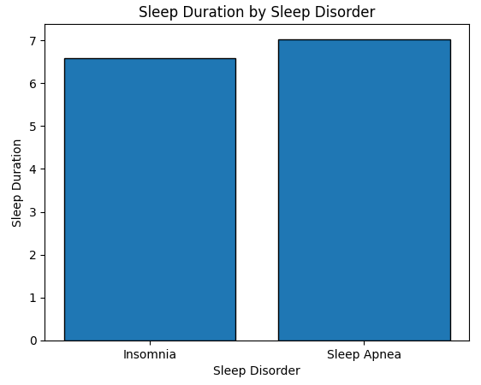
Sleep Disorders Are Associated with Lower Sleep Duration
This graph shows the average sleep duration for each sleep disorder category.
Individuals with sleep disorders tend to have lower sleep duration. For example, those with insomnia appear to get less sleep than those with sleep apnea, suggesting that different disorders may impact sleep differently.

Slide 14
Progress Update – Week 4
What I accomplished:
Added new insights using Heart Rate and Sleep Disorder
Explored additional health-related factors affecting sleep
Plan for next week:
Identify the strongest insights
Begin organizing a clear data story
Obstacles:
None so far
Resources used:
Jupyter Notebook
Contribution:
All work completed individually

Slide 15
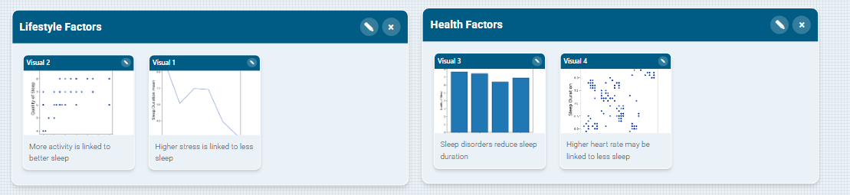
Storyboard Draft
Key Findings Grouped:
Stress → lower sleep duration
Physical activity → better sleep quality
Sleep disorders → affect sleep
Heart rate → may relate to sleep
Story Order:
Stress and sleep
Activity and sleep quality
Health conditions and sleep
Overall impact of lifestyle on sleep
Main Story:
Lifestyle and health factors such as stress, activity level, and health conditions impact sleep duration and quality.

Slide 16
Progress Update – Week 5
What I accomplished:
Organized insights into a clear data story
Created storyboard and grouped key findings
Wrote micro story explaining the dataset
Plan for next week:
Finalize strongest insights
Prepare final presentation/story
Obstacles:
None so far
Resources used:
Jupyter Notebook
Storyboard Studio
Contribution:
All work completed individually

